Slide 1

Introduction to AngularJS
Notes:
Hi. I'm brad green, engineering director in Ads. I've worked on support, testing, accessibility and other areas. But today I'm here to talk about the AngularJS framework.
Angular is a client side javascript framework for building single-page apps aka AJAX applications.
I want to start by talking about the logo. It's important. We picked it to look like a super-hero shield. Not because I think we're super-heroes, but because I think you can be.

Slide 2
Framework for web apps
Notes:
We've seen fantastic applications in web browsers. Starting with Gmail and Maps, Google opened people's imaginations to what's possible.
Today, we see video editors, games, and even IDEs being built in the browser. As a user, this is a fantastic time.
But as a developer, our lives are pretty rough. There's a lot we have to deal with to achieve these amazing applications.

Slide 3
Data Binding
<html ng-app>
<head>
<script src='angular.js'></script>
</head>
<body ng-init="user.name = 'Larry'">
<div>Hi {{user.name}}</div>
</body>
</html>
Notes:
Data binding.
First off, this is a complete Angular application. Since Angular runs all in the client, there's no server necessary to write our templates. This makes Angular great for offline mobile and desktop apps.
Data binding takes away the task of moving data back and forth between your objects and the DOM. You just declare which JavaScript object properties are linked to your UI and Angular does the rest of the work. If a user changes the UI, Angular updates your properties. When you update your properties, Angular updates the UI. Just like a spreadsheet.
Here, I've got a <div> where I want to display the user's name. I'm using Angular's curley-brace syntax to bind the user.name property to part of the template. Whatever that contains gets inserted here. We call this interpolation. I'm using a cheat to set user.name above with ng-init. You likely wouldn't use this in a production app, but it's useful to show off what's going on.
The rest of the template? At the top, notice I've added an attribute ng-app to the HTML element. This tells Angular what part of the DOM is its template to manage.

Slide 4
Data Binding
<html ng-app>
<head>
<script src='angular.js'></script>
</head>
<body>
<input ng-model='user.name'>
<div ng-show='user.name'>Hi {{user.name}}</div>
</body>
</html>
Notes:
Data binding.
First off, this is a complete Angular application.

Slide 5
Structure
Data
UI
Logic
Notes:
Model - View - Controller. Or data-presentation-logic. Whatever you call it, separating the responsibilities of your application is THE critical key to making it easy to test, extend, maintain, refactor, and understand.
In Angular we create the view in DOM from an HTML template. Our controllers are JavaScript classes and the model is just any JavaScript object or primitive.

Slide 6
Structure: MVC
Model
Notifies
View
Changes
Notifies
Controller
Notes:
Model - View - Controller. Or data-presentation-logic. Whatever you call it, separating the responsibilities of your application is THE critical key to making it easy to test, extend, maintain, refactor, and understand.
In Angular we create the view in DOM from an HTML template. Our controllers are JavaScript classes and the model is just any JavaScript object or primitive.

Slide 7
MVC
Model
JS Objects
View
DOM
Controller
JS Classes
Notes:
Model - View - Controller. Or data-presentation-logic. Whatever you call it, separating the responsibilities of your application is THE critical key to making it easy to test, extend, maintain, refactor, and understand.
In Angular we create the view in DOM from an HTML template. Our controllers are JavaScript classes and the model is just any JavaScript object or primitive.

Slide 8
MVC
<html ng-app>
<head>
<script src='angular.js'></script>
<script src='controllers.js'></script>
</head>
<body ng-controller='UserController'>
<div>Hi {{user.name}}</div>
</body>
</html>
function UserController($scope) {
$scope.user = { name:'Larry' };
}
index.html
controllers.js

Slide 9
Templates = HTML + Directives
Notes:
Controllers should 'just ask' for dependencies they need by placing them in their constructor

Slide 10
Directives as template
{{user.name}}
<li ng-repeat='item in items'>
{{item.name}}
</li>
<ng-view></ng-view>
Notes:
Directives let you extend HTML's syntax.

Slide 11
Directives as configuration
<div ng-controller='UserCtrl'>
...
</div>
<input ng-model='user.name'>
<div ng-show='user.name'>Hi {{user.name}}</div>
Notes:
Directives let you extend HTML's syntax.

Slide 12


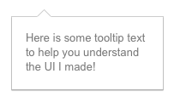
Directives as components
<rating max='5' model='stars.average'>
<tabs>
<tab title='Active tab' view='...'>
<tab title='Inactive tab' view='...'>
</tabs>
<tooltip content='messages.tip1'>
Notes:
Directives let you extend HTML's syntax.

Slide 13
Directives as anything!
var mod = angular.module('directives', []);
mod.directive('focus', function() {
return {
link: function(scope, element, attrs) {
element[0].focus();
}
};
});
<form name='myForm'>
<input ng-model='user.firstName' focus>
<input ng-model='user.lastName'>
...
</form>
directives.js
view1.html

Slide 14
Awesome things not covered:
Filters
Promises
Localization
Form validation
Views & Routes
Server communication
Unit and scenario tests
Services & Dependency Injection
...and much more!

Slide 15
Tools & Resources

Slide 16
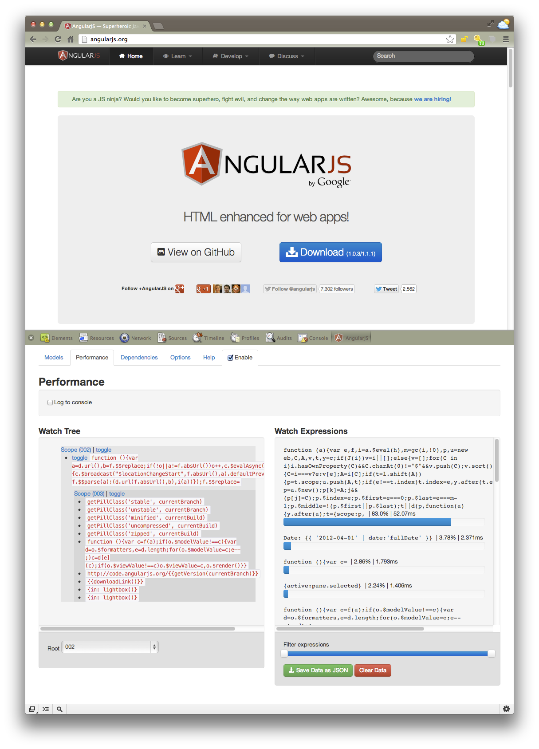
Chrome debugger
"Batarang"
Notes:
The angular deubgger built into chrome makes it easy to trace your data bindings and discover performance problems.

Slide 17
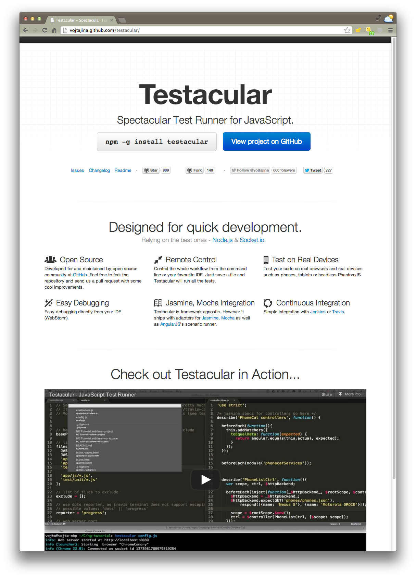
1.6K tests in 3 sec
=
life changing
Notes:
Our test runner, Testacular, runs tests every time you save any project file. It runs on real browsers, lightening fast. Our 1.6K tests for AngularJS run in 3 seconds. Running this fast on every save, tests become a truly informative part of a tight development cycle rather than a bit of feedback you get from a CI server.

Slide 18
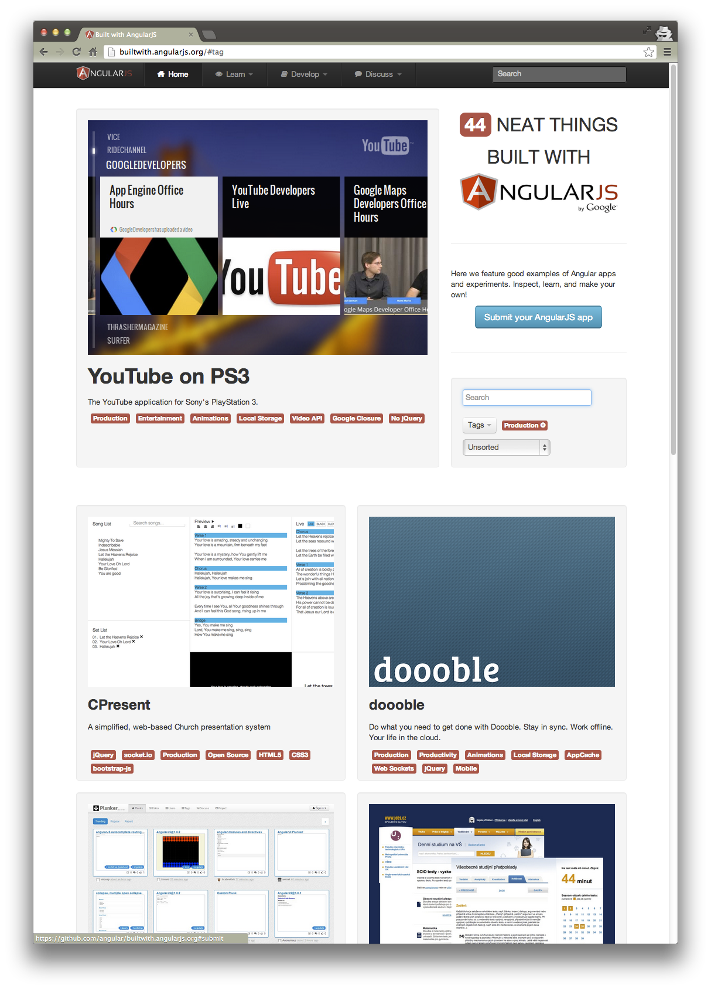
builtwith.angularjs.org

Slide 19
Main Site
angularjs.org
Tutorials & Samples
*** egghead.io ***
AngularJS tutorial
Example apps
Chrome app tutorial
Apps
builtwith.angularjs.org
Tools
Testacular
Batarang

Slide 20
G+/twitter:
@bradlygreen

